Slide 1
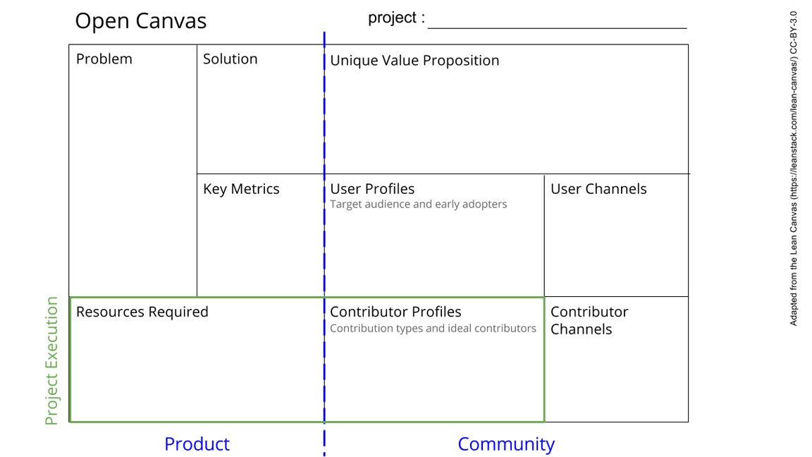
Firefox Browser to Browser(B2B) Radio Communication for Internet Access
User is refused for Internet Connection(wireless/wired).
When Specific user is censored to access web
Firefox addon + GNU radio communication between two systems : for b2b communication
A system/Device which is censored(refused internet connection) to access Web, can Privately access Web:
# Radio Communication between Browser(System with no Internet connection/Web access) to Browser (nearby System with Internet/Web Access ) .
# Hide True (IP) address of the Originating system.
Alpha >Beta > Stable release with larger community participation & adaption
Github Gitter
Talks, Discussions and Continues development of project from contributos.
Open Community, Hacktivist and everyone else who needs healthy internet access.
Knowledge on GNU radio, Low cost SDR hardware, System Communication , Firefox Addon framework and Open Internet policies.
Intention for Community based Internet development and one or more skill set in “Resources Required” for contributions.
Github Gitter
Adapt this work for their personal projects with community contribution.
Notes:
Go to File > Make a Copy… to make your own canvas
See next slide for instructions

Slide 2
